Slide 1
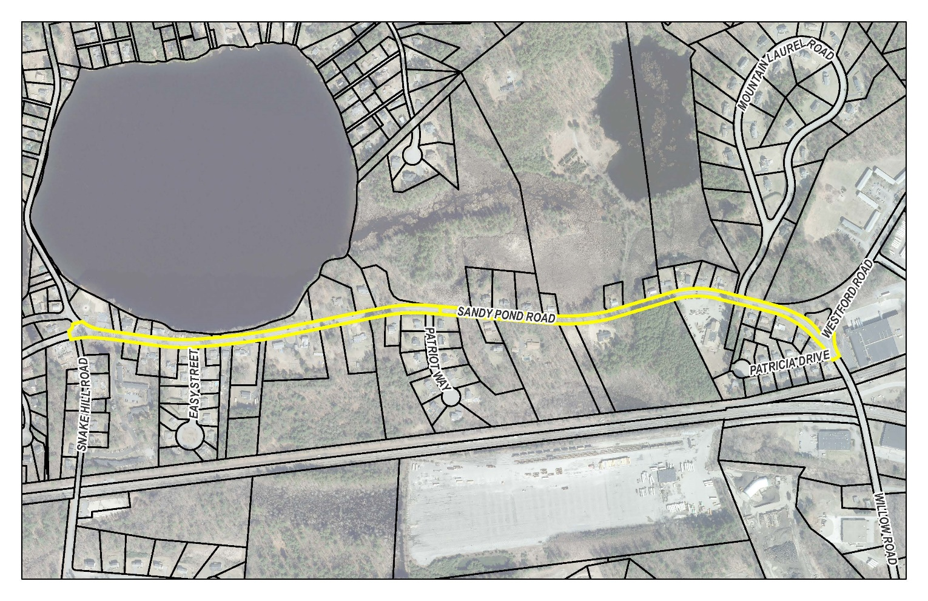
Public Input Meeting Sandy Pond Road Complete Streets Improvements
Town of Ayer
Department of Public Works
September 13th,
2023

Slide 2
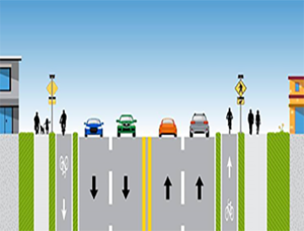
What is a Complete Street?
MassDOT: “A Complete Street is one that provides safe and accessible options for all travel modes – walking, biking, transit and vehicles – for all ages and disabilities”.

Slide 3
MassDOT Complete Streets Funding Program
2016: MassDOT launched Complete Streets funding program
Up to $500,000 available to participating communities every four years

Slide 4
Sandy Pond Road (Snake Hill Road to Westford Road)
50’ right-of-way, 4,800’ long (0.9 miles)
30’ wide road (13’ wide travel lanes, 1’ – 2’ wide shoulders)
No sidewalks, curbing, bike lanes, or ADA compliant crossings

Slide 5
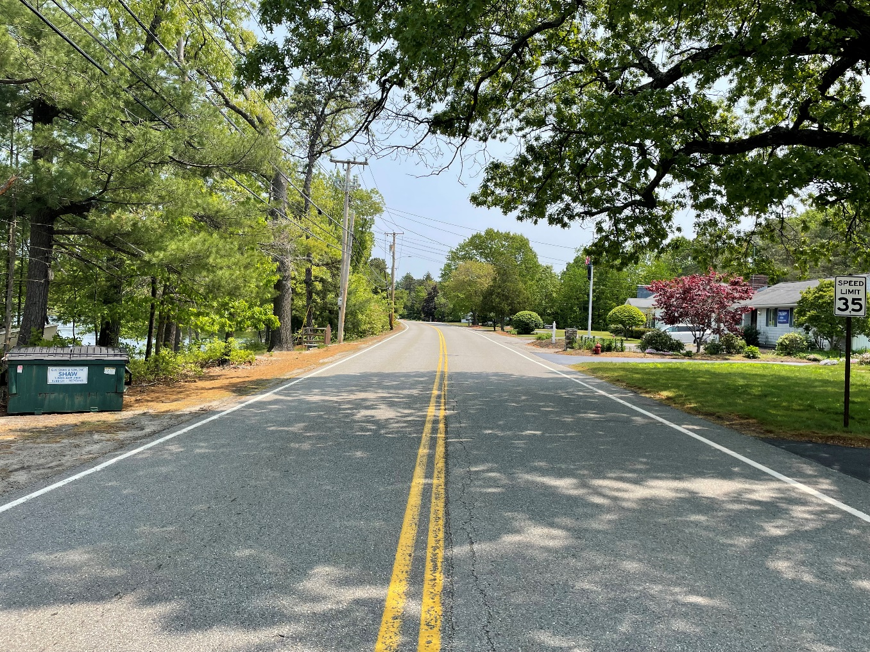
Sandy Pond Road – Typical Section

Slide 6
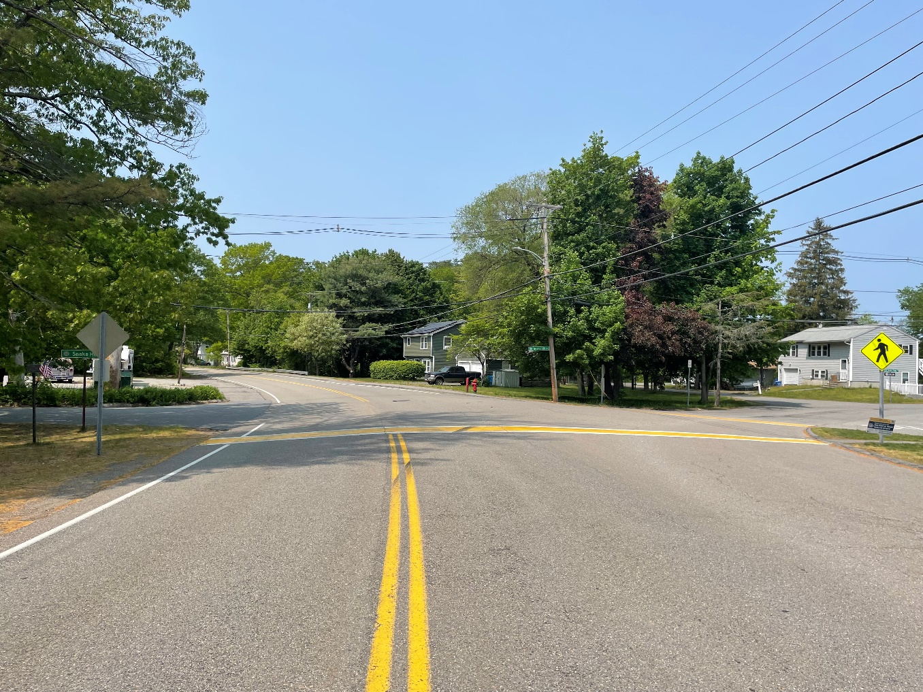
Sandy Pond Road at Snake Hill Road

Slide 7
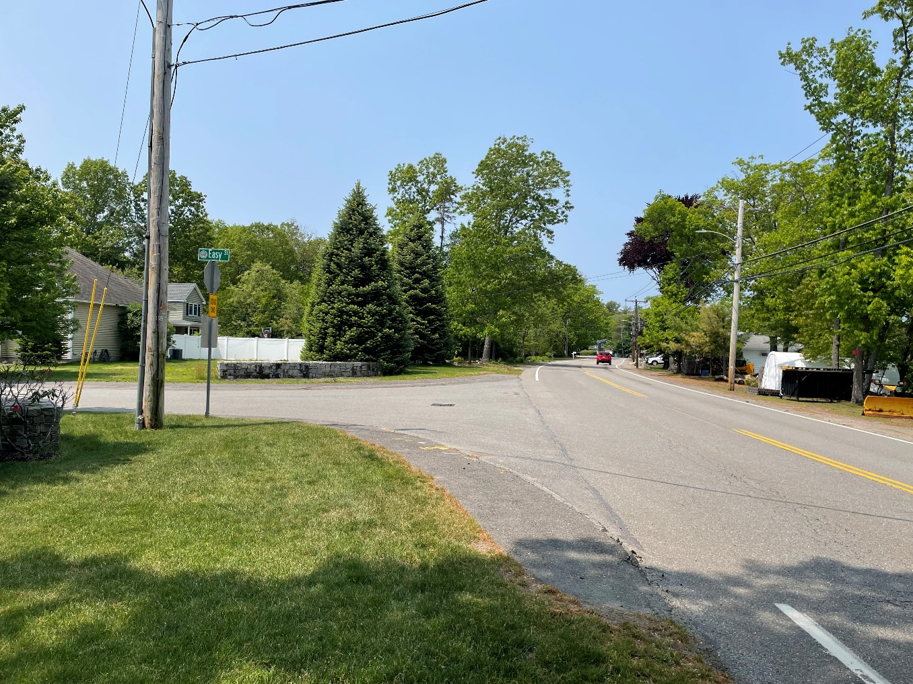
Sandy Pond Road at Easy Street

Slide 8
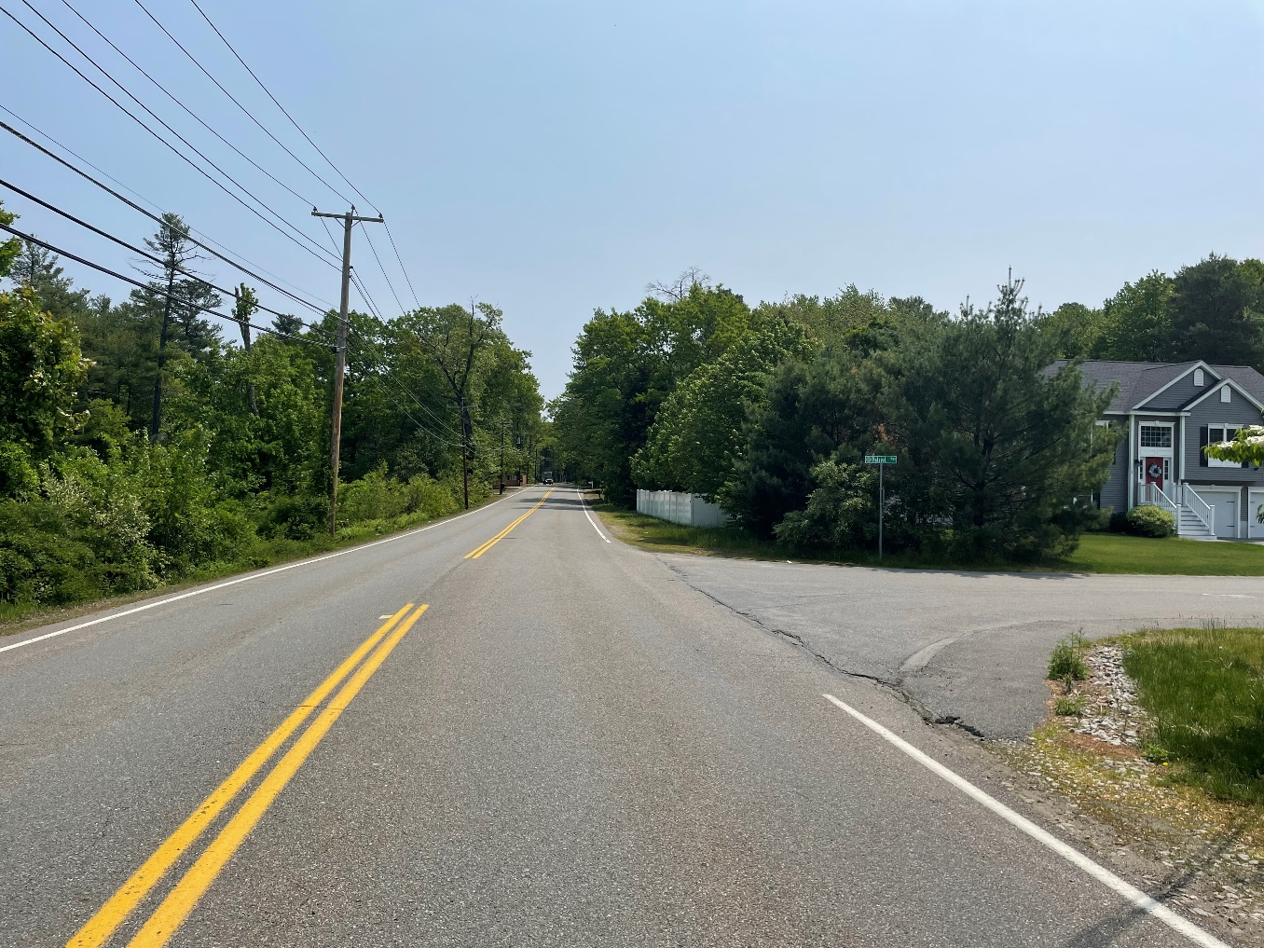
Sandy Pond Road at Patriot Way

Slide 9
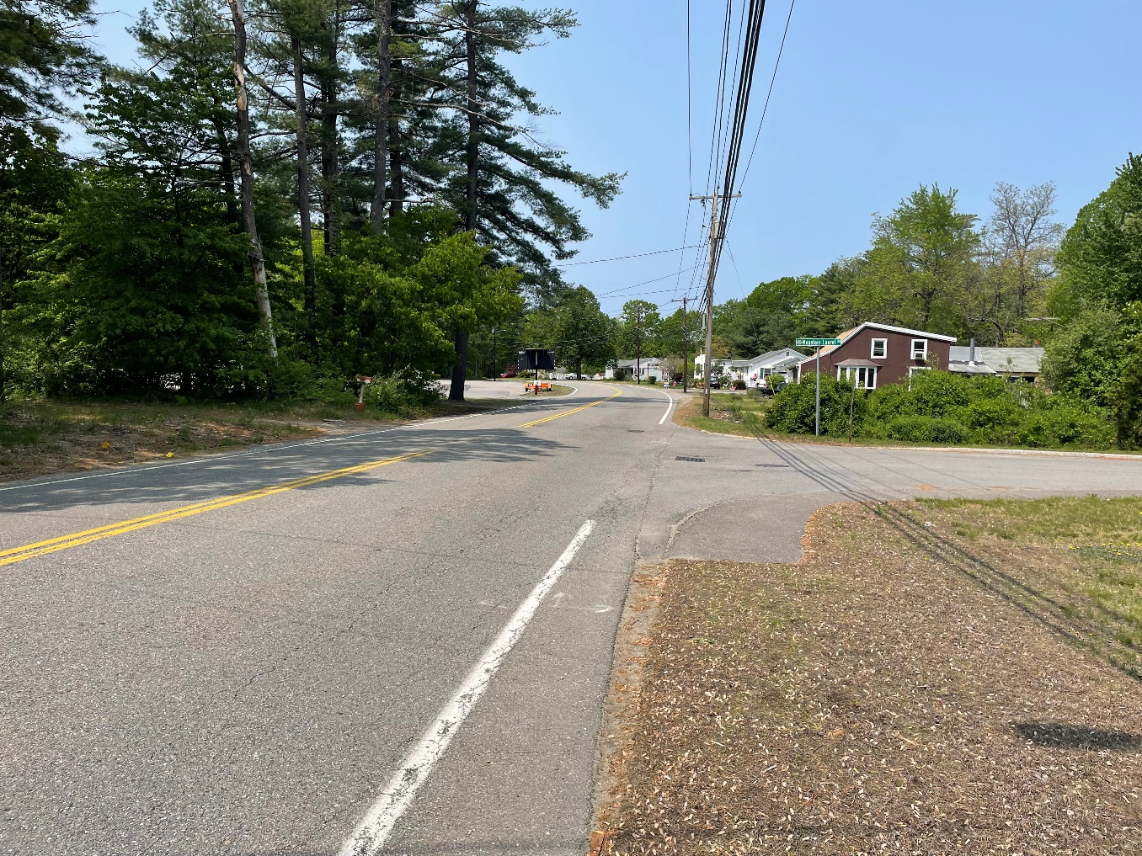
Sandy Pond Road at Mountain Laurel Road

Slide 10
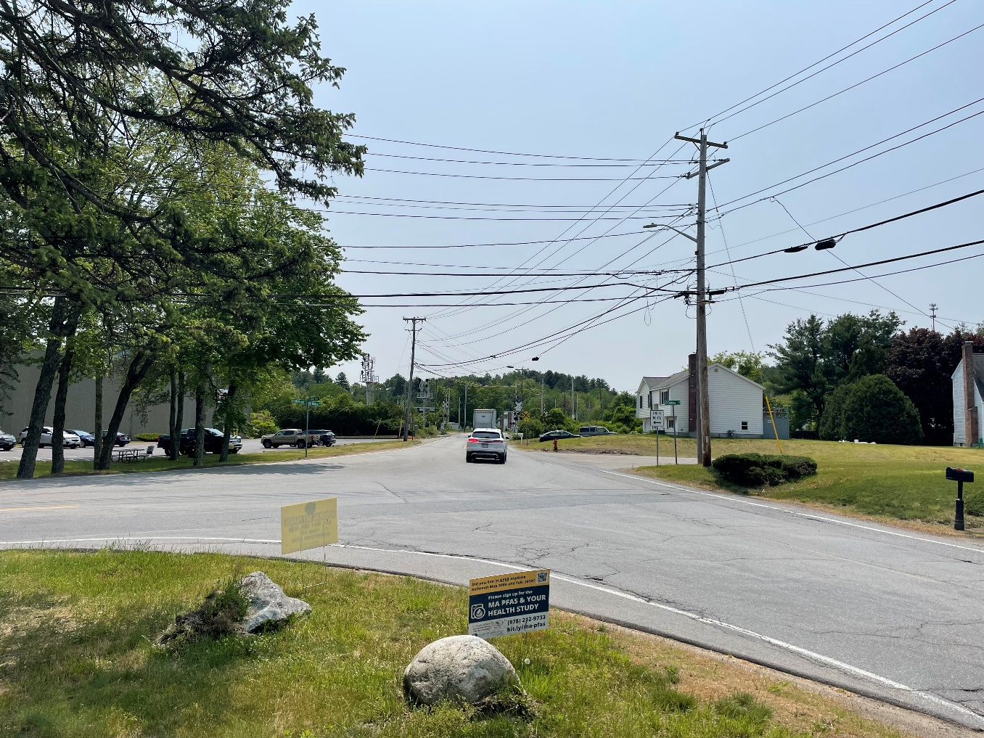
Sandy Pond Road at Westford Rd & Willow Rd

Slide 11
Sandy Pond Road – Complete Streets Study (Snake Hill Road to Westford Road)
The DPW requested funding from Town Meeting for the Study after receiving numerous requests to complete the project
Ayer DPW contracted with Consultant to provide complete street conceptual design & cost estimate
Two concept options studied

Slide 12
Concept ‘A’ – Shared Use Path
11’ wide travel lanes with 2’ wide shoulders
8’ to 10’ wide “shared-use” path (south side of roadway)
Mill & overlay of roadway + pavement markings
Drainage upgrades and granite curbing
Flashing Beacons (Snake Hill Road and Mount Laurel Road)
Preliminary Estimate: $1,800,000

Slide 13
Concept ‘B’ – Sidewalk & Bike Lanes
11’ wide travel lanes with 5’ wide bike lanes (each side)
5’ wide sidewalk (south side of roadway)
Mill & overlay of roadway and new pavement markings
Drainage upgrades and granite curbing
Flashing Beacons (Snake Hill Road and Mount Laurel Road)
Preliminary Estimate: $1,700,000

Slide 14
Consultant’s Conclusion
Concept ‘B’ (Sidewalk & Bike Lanes) is preferred
Cost can be reduced significantly through value engineering
Recommend phasing construction to maximize use of funding

Slide 15
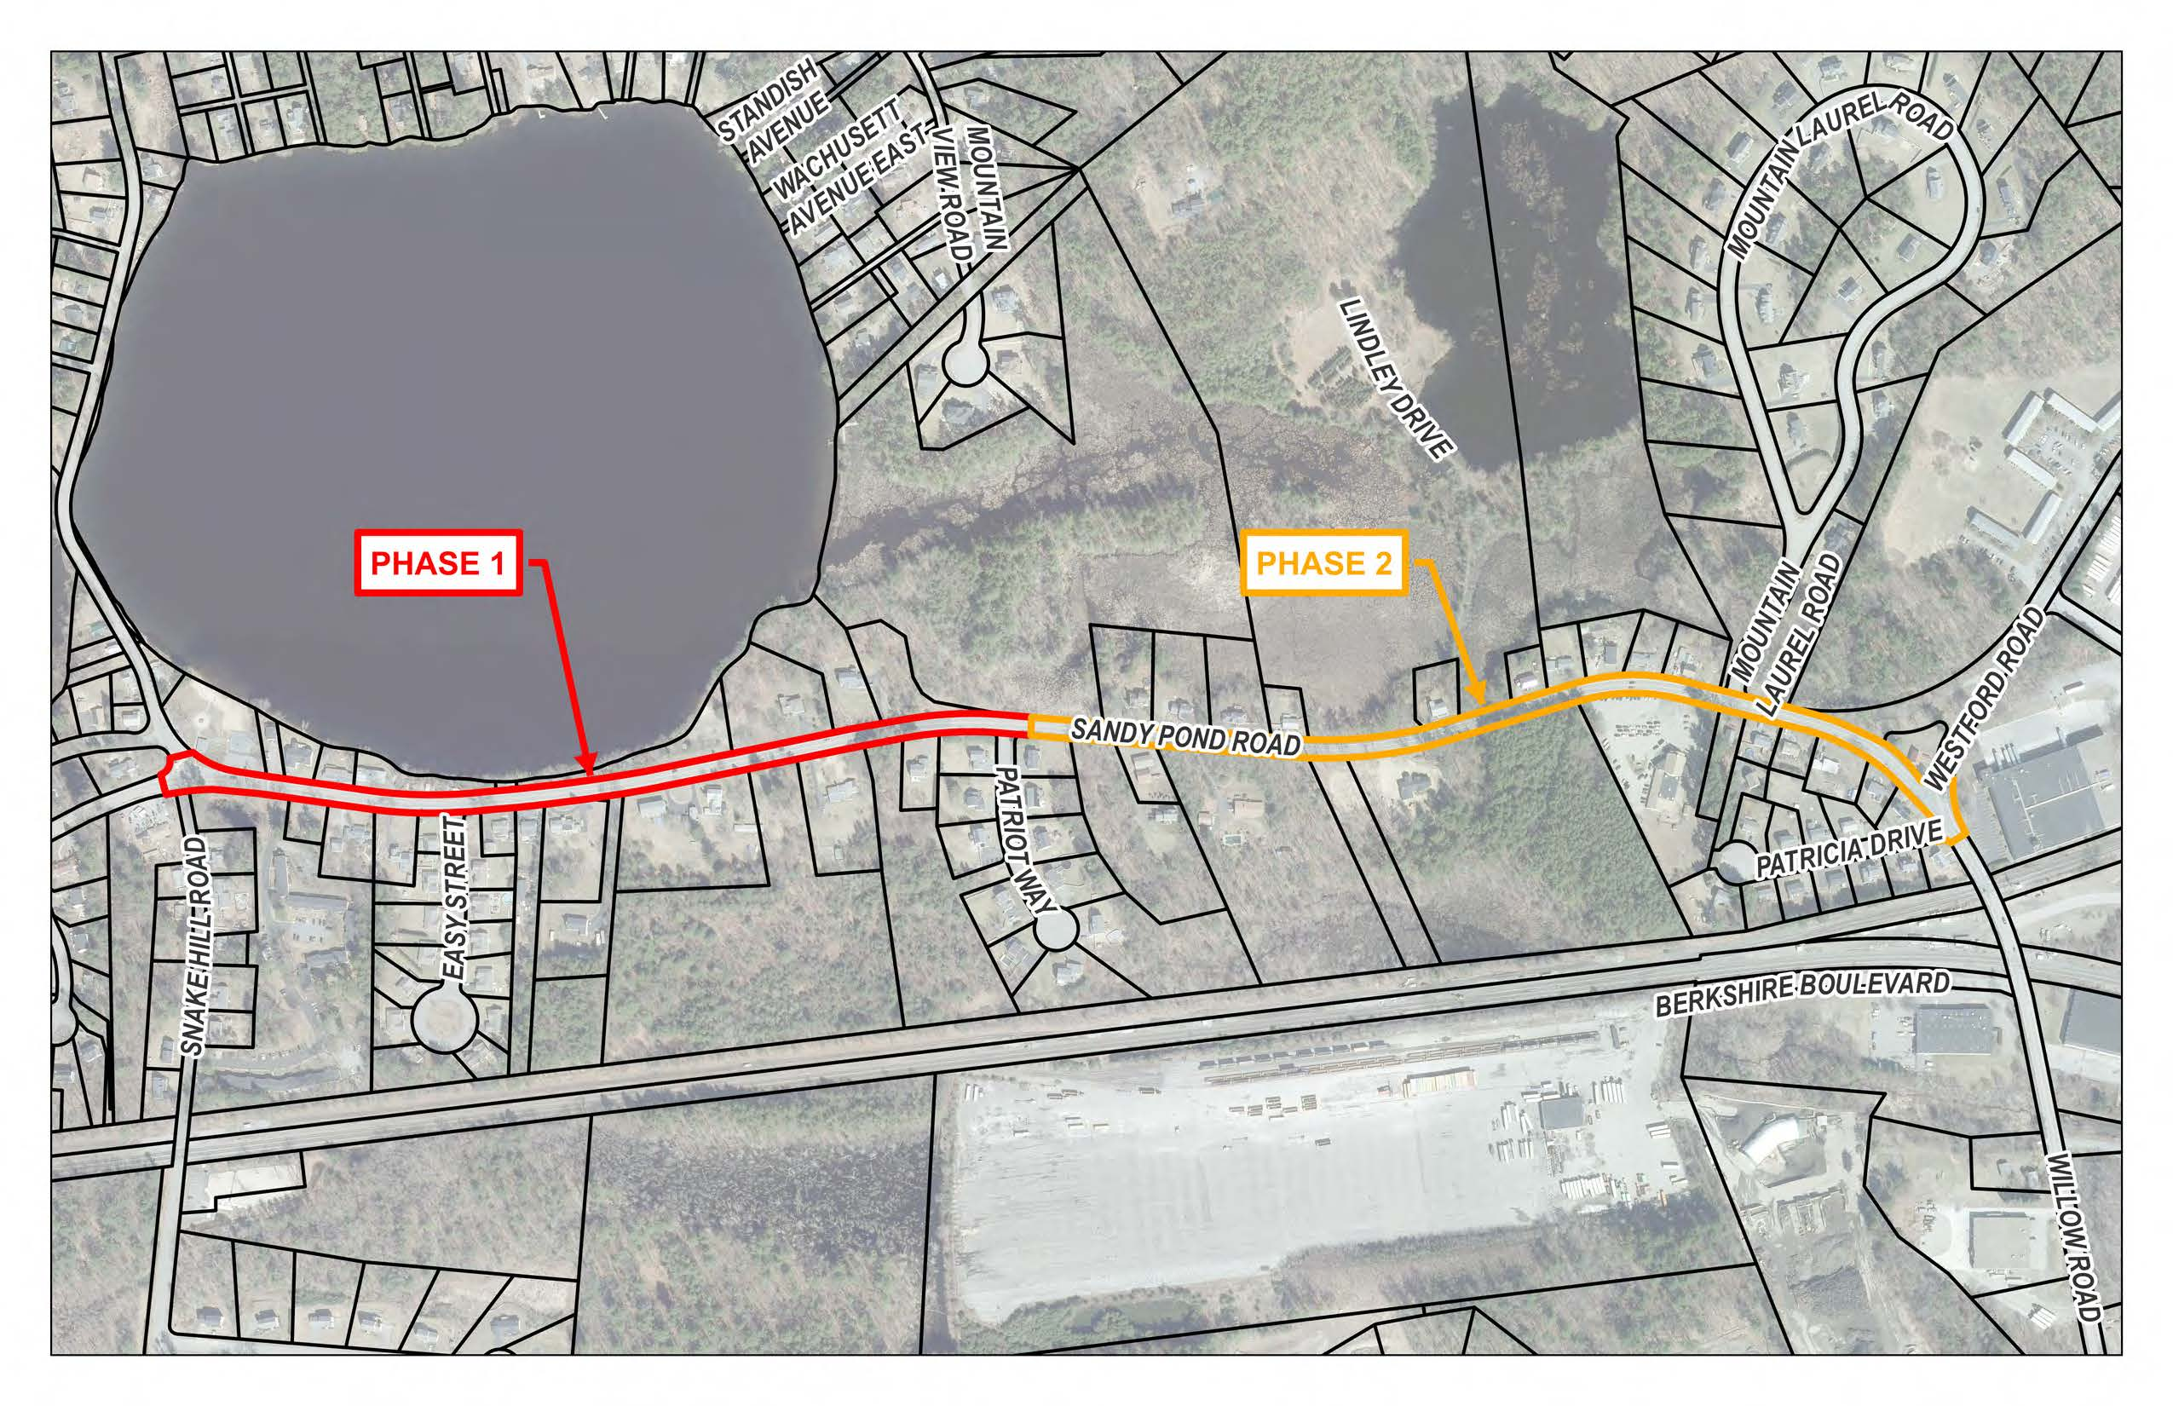
Recommended Construction Phasing

Slide 16
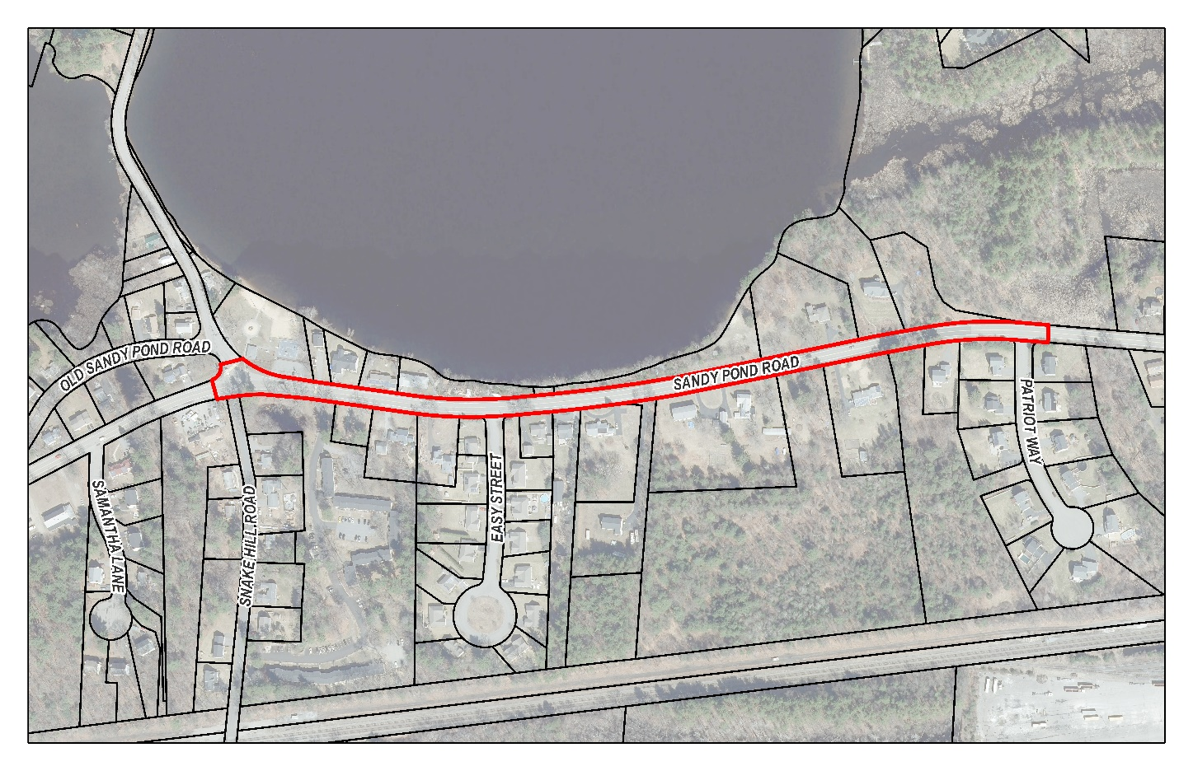
Sandy Pond Road Phase 1
Snake Hill Road to Patriot Way (2024/2025)

Slide 17
Sandy Pond Road Phase 1
Snake Hill Road to Patriot Way (2024/2025)
August 2023 – Ayer DPW awarded grant for $500,000 to construct Phase 1 (Snake Hill Road to Patriot Way).
Ayer DPW to provide design, permitting, and construction management of Phase 1 work

Slide 18
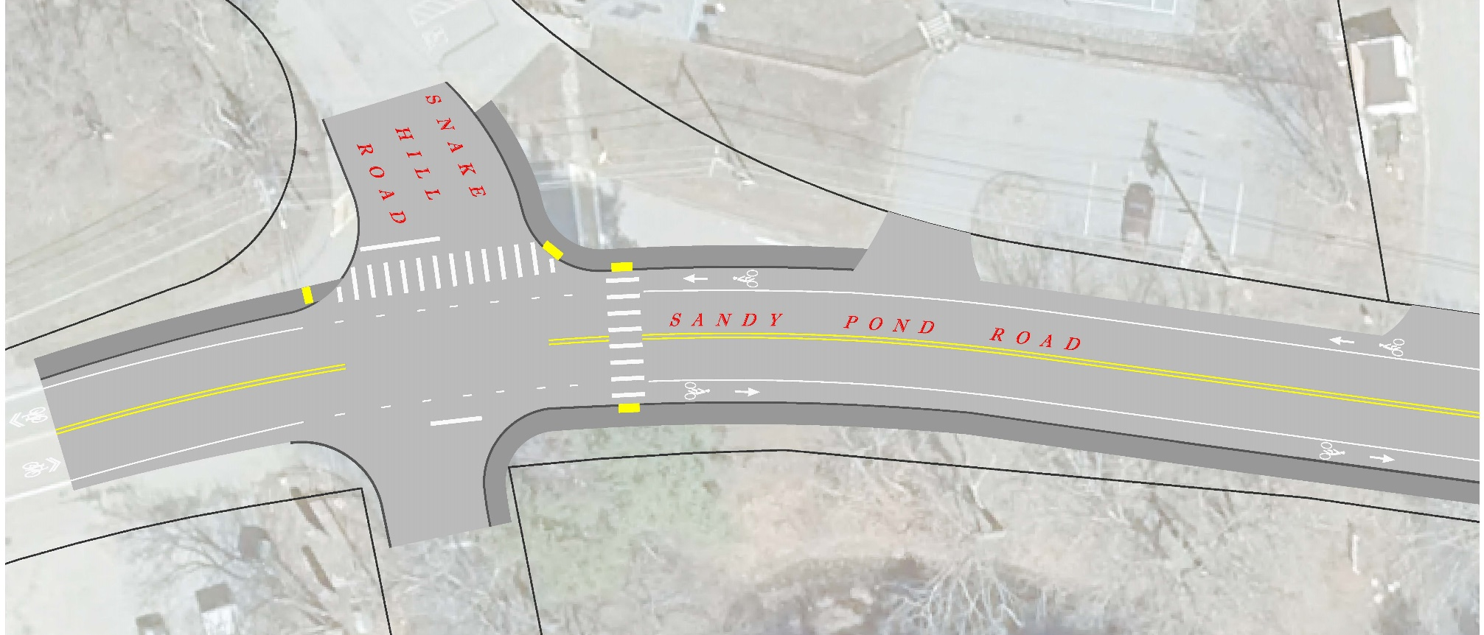
Sandy Pond Road at Snake Hill Road Conceptual Plan

Slide 19
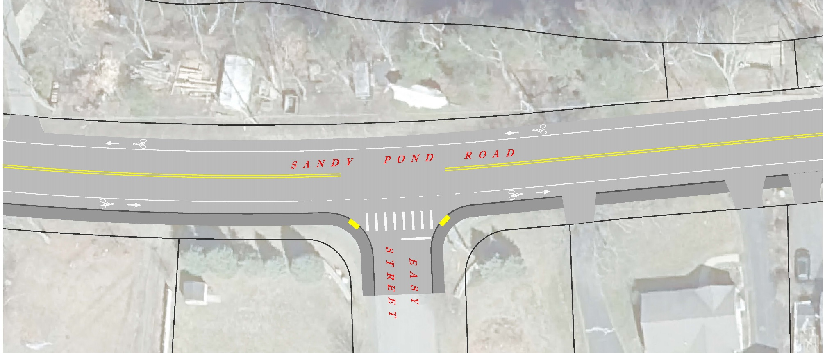
Sandy Pond Road at Easy Street Conceptual Plan

Slide 20
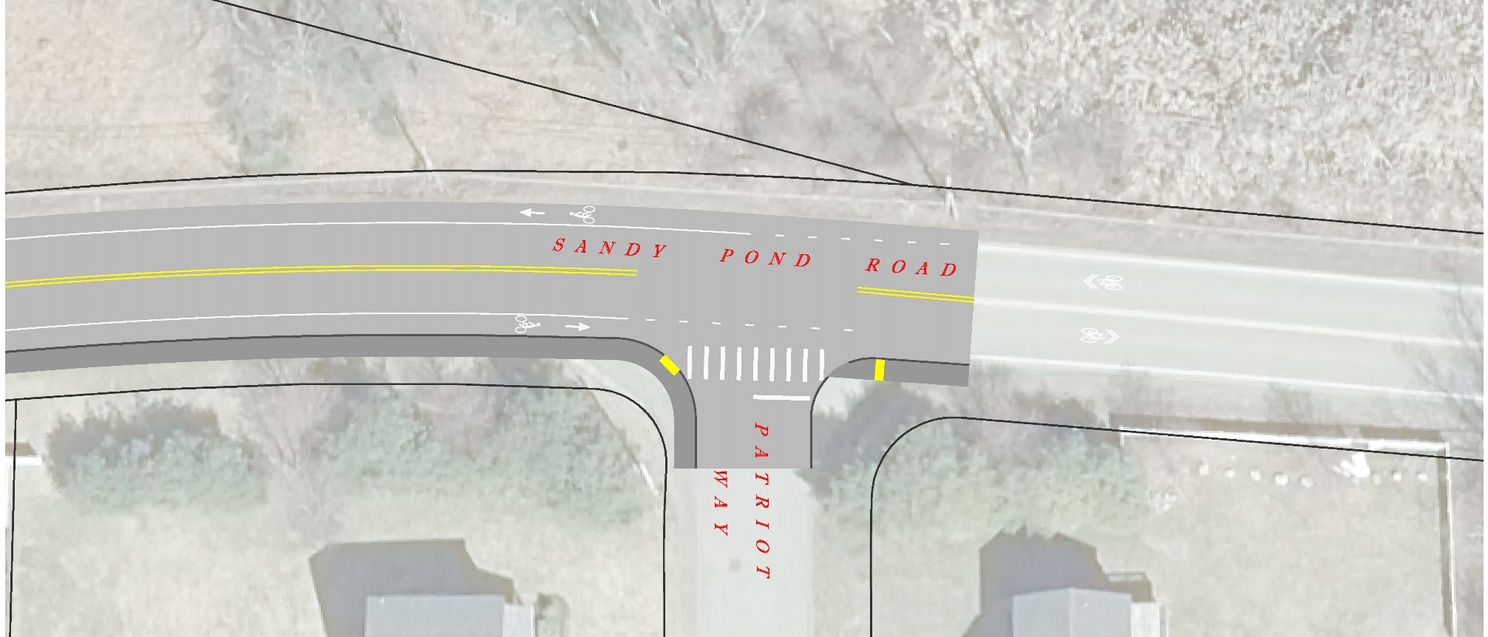
Sandy Pond Road at Patriot Way Conceptual Plan

Slide 21
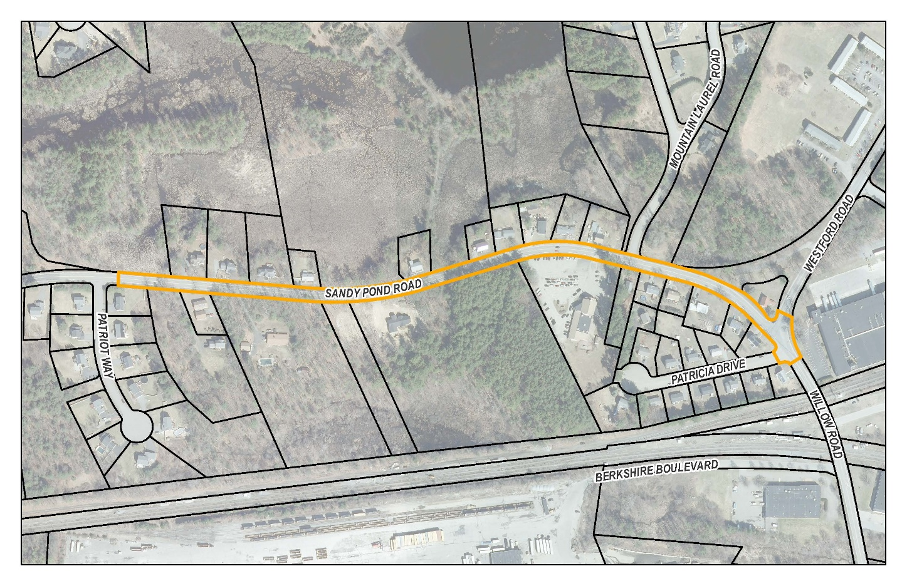
Sandy Pond Road Phase 2 (Date TBD)
Patriot Way to Westford Road

Slide 22
Sandy Pond Road Phase 2 (Date TBD)
Patriot Way to Westford Road
Phase 2 can be value-engineered close to $500,000
DPW investigating other funding alternatives to expedite Phase 2 construction
DPW would wait until 2027 to apply for Phase 2 Construction through MassDOT Complete Streets Funding

Slide 23
Next Steps
Implement public input into Phase 1 design & planning
Design Phase 1 work (construction plans & specifications)
Place Phase 1 project out for bid and award contract
Contact direct abutters once a construction schedule has been set for Phase 1
Continue to seek available funding for Phase 2 construction

Slide 24
Thank You
Dan Van Schalkwyk, p.e., Director of public works
Matt herNON, P.E., TOWN ENGINEER

